Slide 1
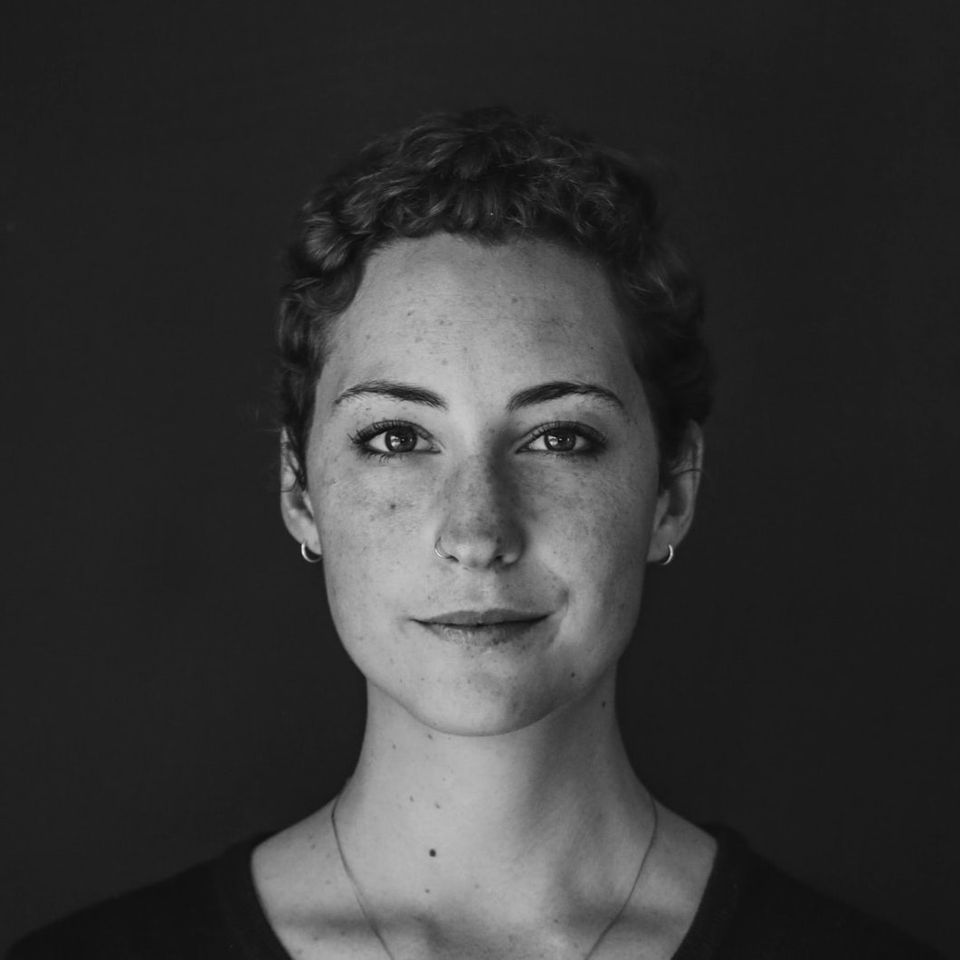
MARTHA PERRY
BRAND MANAGER
I spend every staff-meeting wondering how they got the table through the door. My boss thinking how to fire me without compensation. We are equally productive.
EXPERIENCE
CONTACT
JOB TITLE, COMPANY. 2007 - 2009
Led multi-year, $100k program to design, implement, deploy, support and train employees to use a corporate intranet built on SharePoint 2010. Proposed, designed, and built web-based tools for request tracking and IT change management. Prepared and delivered training materials for using.
+1 (234) 567-8900
1234 SW 40 St, City, State, Country
username@domain.com
JOB TITLE, COMPANY. 2007 - 2009
Led multi-year, $100k program to design, implement, deploy, support and train employees to use a corporate intranet built on SharePoint 2010. Proposed, designed, and built web-based tools for request tracking and IT change management. Prepared and delivered training materials for using.
www.your-domain.com
linkedin.com/username
SKILLS
JOB TITLE, COMPANY. 2007 - 2009
Led multi-year, $100k program to design, implement, deploy, support and train employees to use a corporate intranet built on SharePoint 2010. Proposed, designed, and built web-based tools for request tracking and IT change management. Prepared and delivered training materials for using.
Adobe Creative Cloud
Microsoft Office
Planning
EDUCATION
Spanish
BACHELOR / DEGREE TITLE
University Name
2009 - 2013
BACHELOR / DEGREE TITLE
University Name
2014 - 2016
Mandarin
BACHELOR / DEGREE TITLE
University Name
2009 - 2013
BACHELOR / DEGREE TITLE
University Name
2014 - 2016
Sketch
REFERENCES
INTERESTS
JONATHAN SMITH
Company, Position
+1 (234) 567-8900
ANNE M. ROSE
Company, Position
+1 (234) 567-8900
Traveling, gaming, listening to music, reading, coffee.

